Slide 1
L06.01 Graph, Breadth-First-Search (BFS)
50.004 Introduction to Algorithm
Dr. Simon LUI
ISTD, SUTD

Slide 2
Overview
What is graph
4 ways to represent a graph
How to construct a tree from graph
BFS (today)
DFS (next lecture)

Slide 3
1. GRAPH

Slide 4
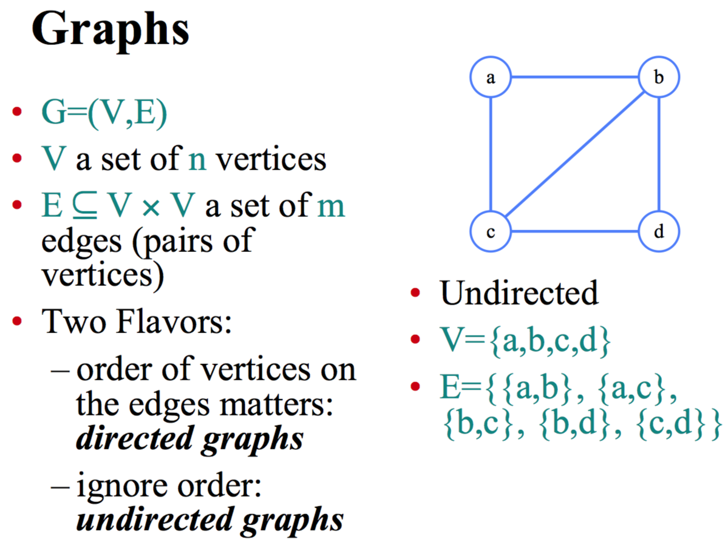

Slide 5
Examples
Undirected
V={a,b,c,d}
E={{a,b}, {a,c}, {b,c}, {b,d}, {c,d}}
Directed
V = {a,b,c}
E = {(a,c), (a,b) (b,c), (c,b)}
a
a
b
b
c
c
d

Slide 6
Instances/Applications
Social Network
friend finder
Computer Networks
internet routing
connectivity
Game states
rubik’s cube, chess
Music
Auto accompaniment, chord progression

Slide 7
Let’s look at one example – Pocket Cube

Slide 8
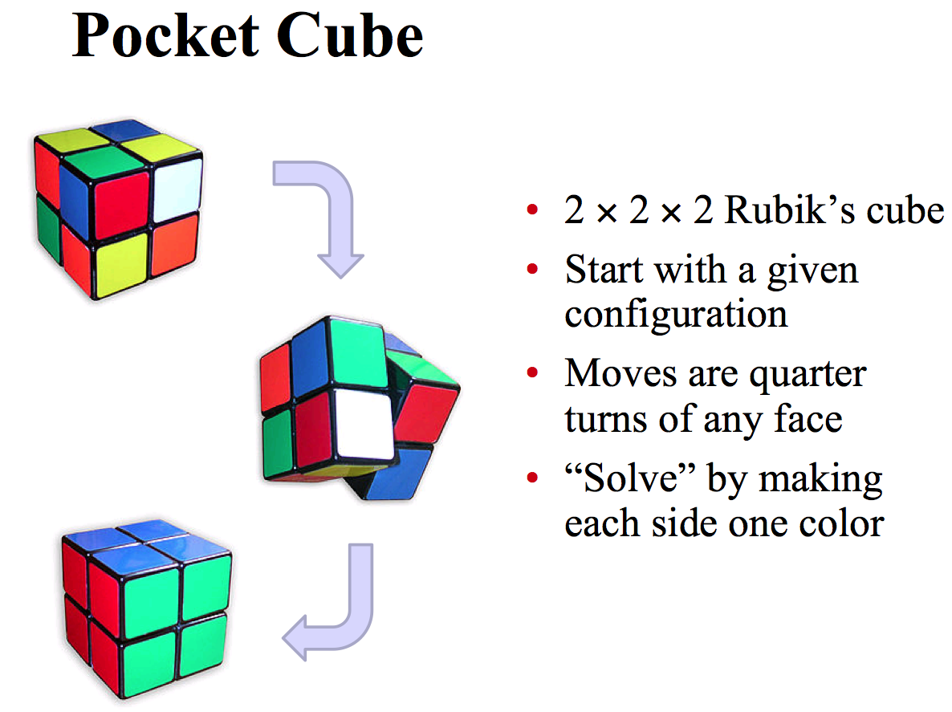

Slide 9
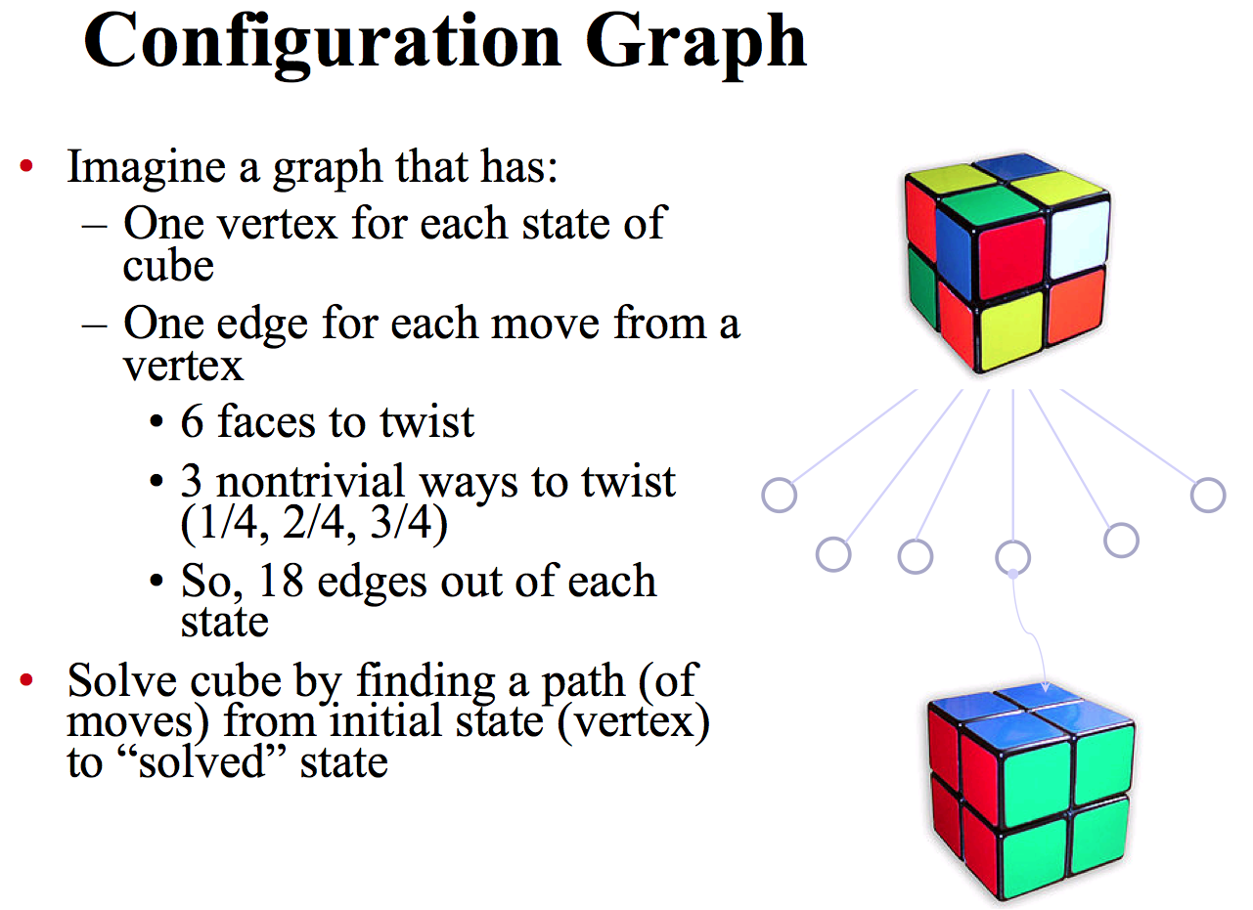

Slide 10
State exploration
distance | 90° | 90° and 180°
0 | 1 | 1
1 | 6 | 9
2 | 27 | 54
3 | 120 | 321
4 | 534 | 1847
5 | 2,256 | 9,992
6 | 8,969 | 50,136
7 | 33,058 | 227,526
8 | 114,149 | 870,072
9 | 360,508 | 1,887,748
10 | 930,588 | 623,800
11 | 1,350,852 | 2,644
12 | 782,536
13 | 90,280
14 | 276
One start vertex
6 others reachable by one 90° turn
From those, 27 others by another
And so on
Can be solved in at most 11 or 14 steps

Slide 11
Four Representation of graph
To solve graph problems, must examine graph
So need to represent in computer
Four representations with pros/cons
Adjacency lists (of neighbors of each vertex)
Incidence lists (of edges from each vertex)
Adjacency matrix (of which pairs are adjacent)
Implicit representation (as neighbor function)

Slide 12
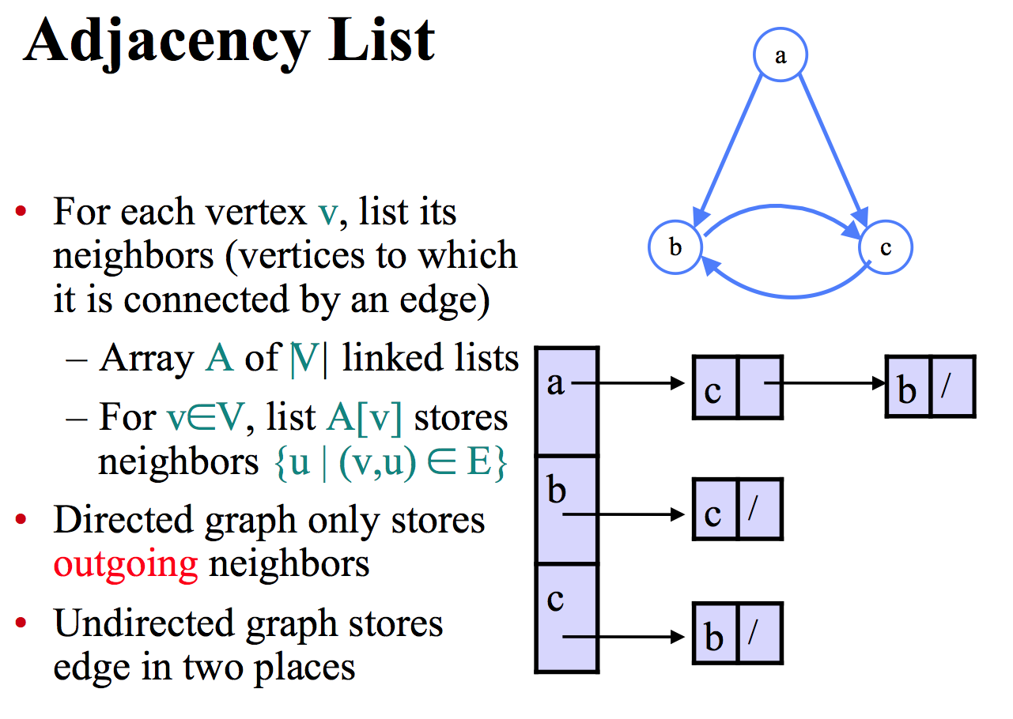

Slide 13
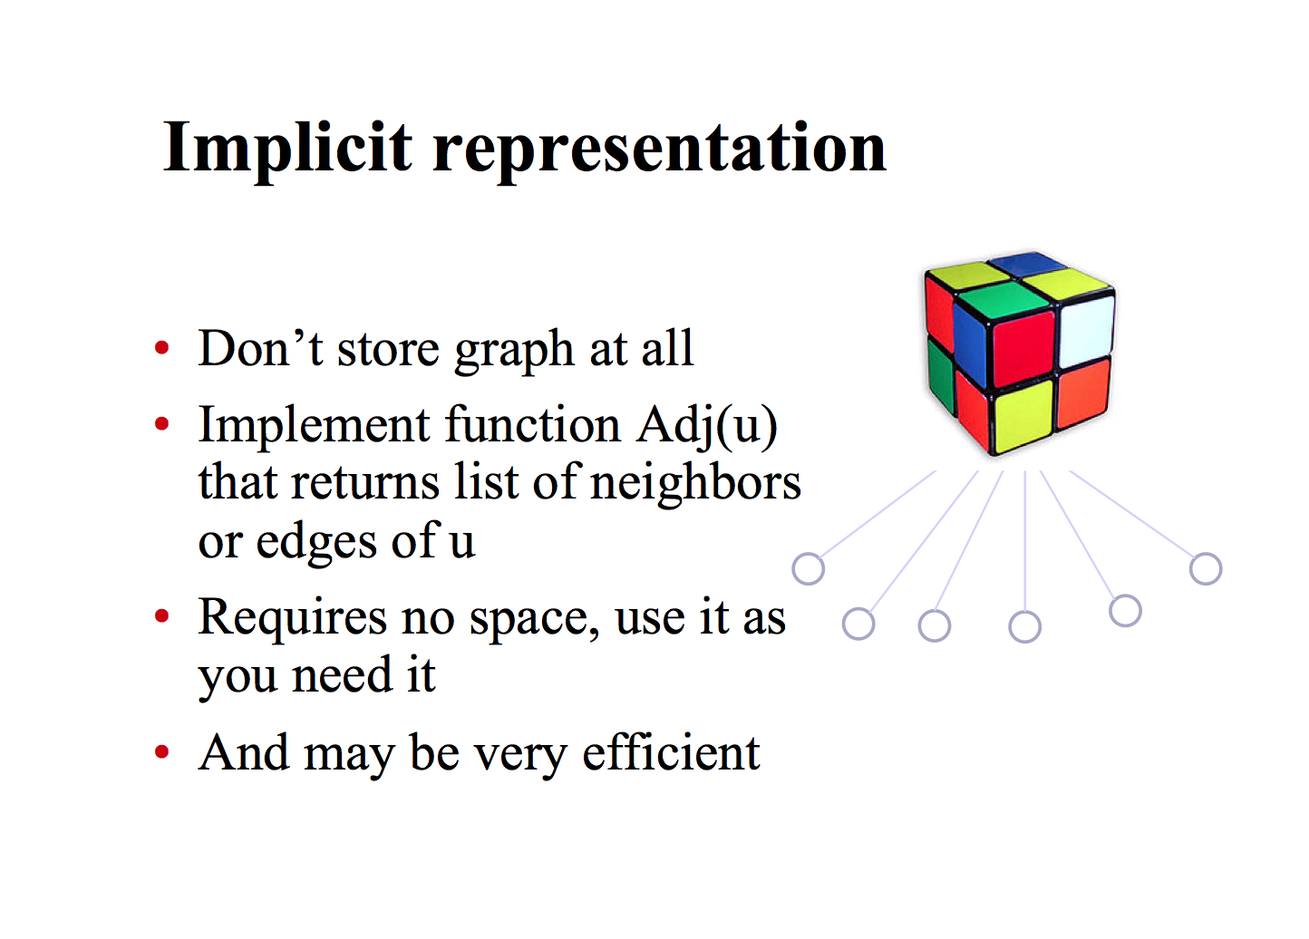

Slide 14
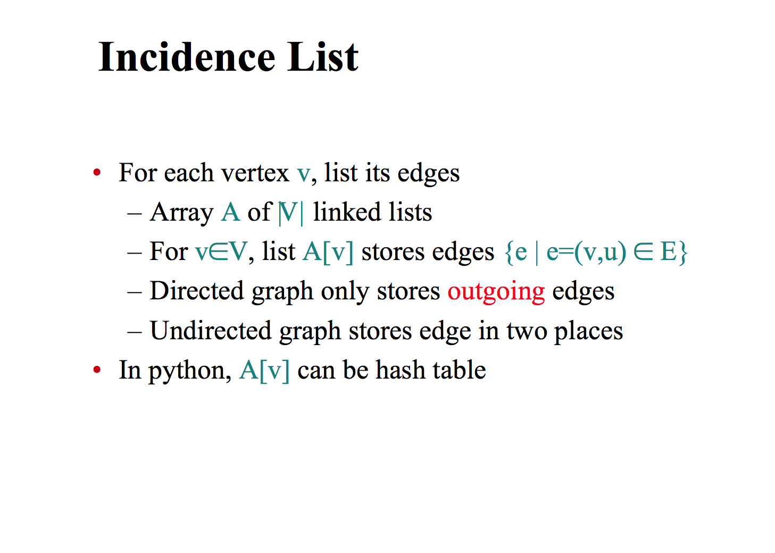

Slide 15
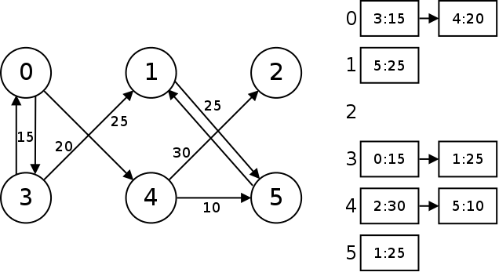
Incidence list - example

Slide 16
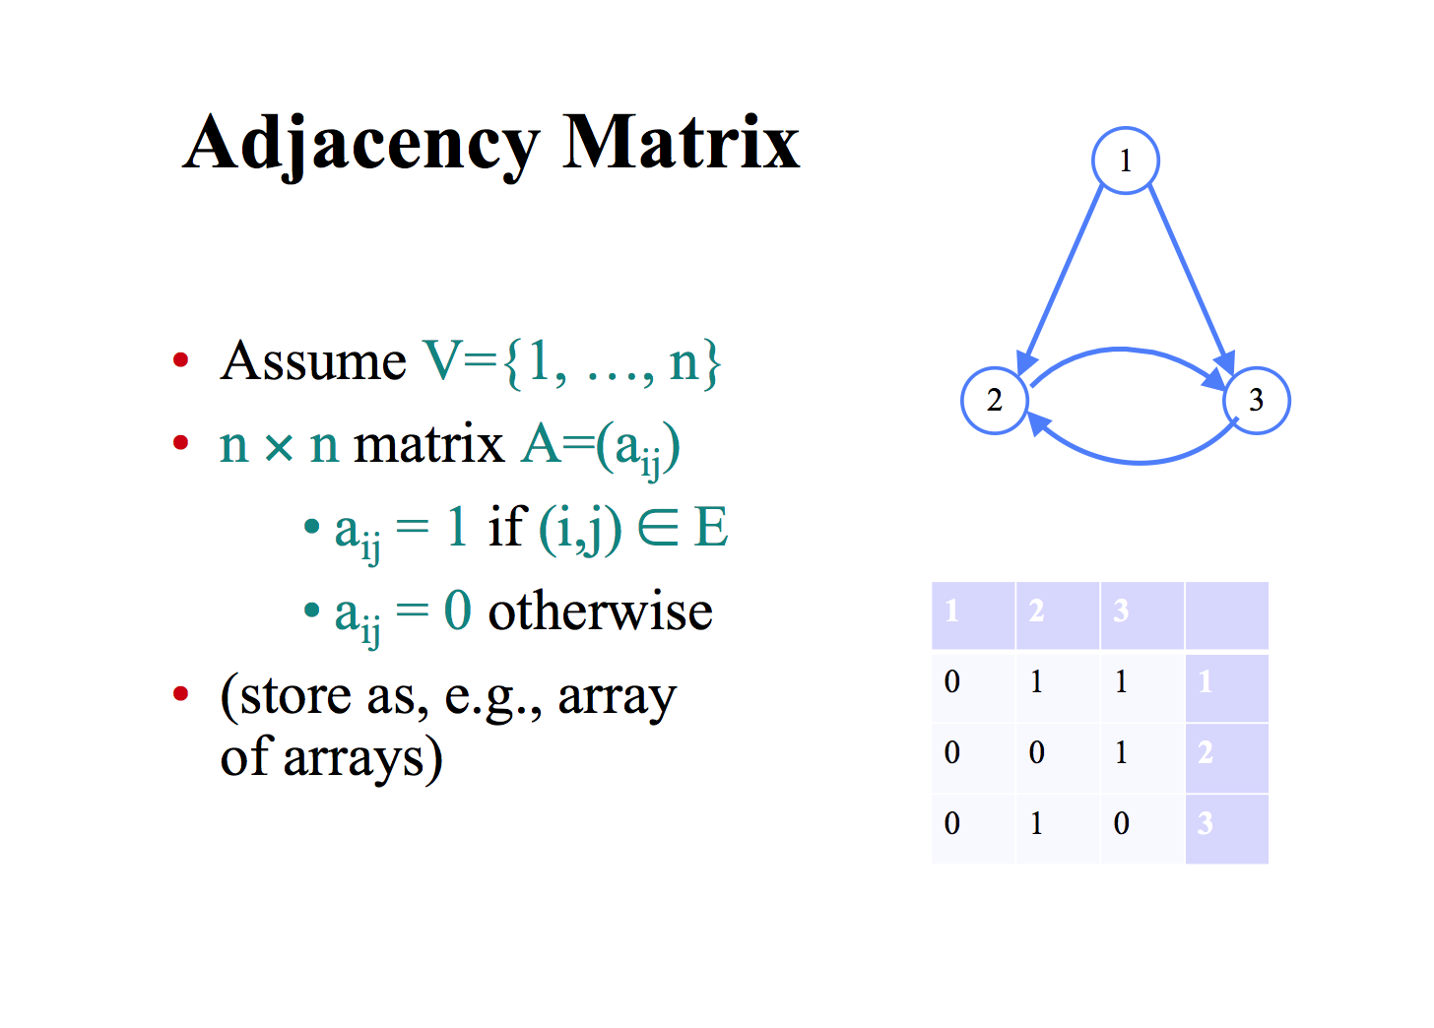

Slide 17
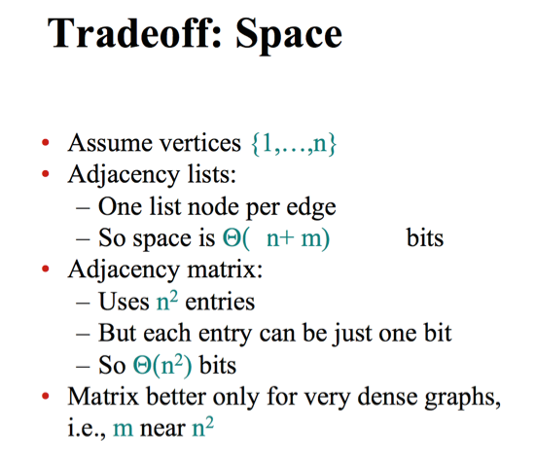

Slide 18
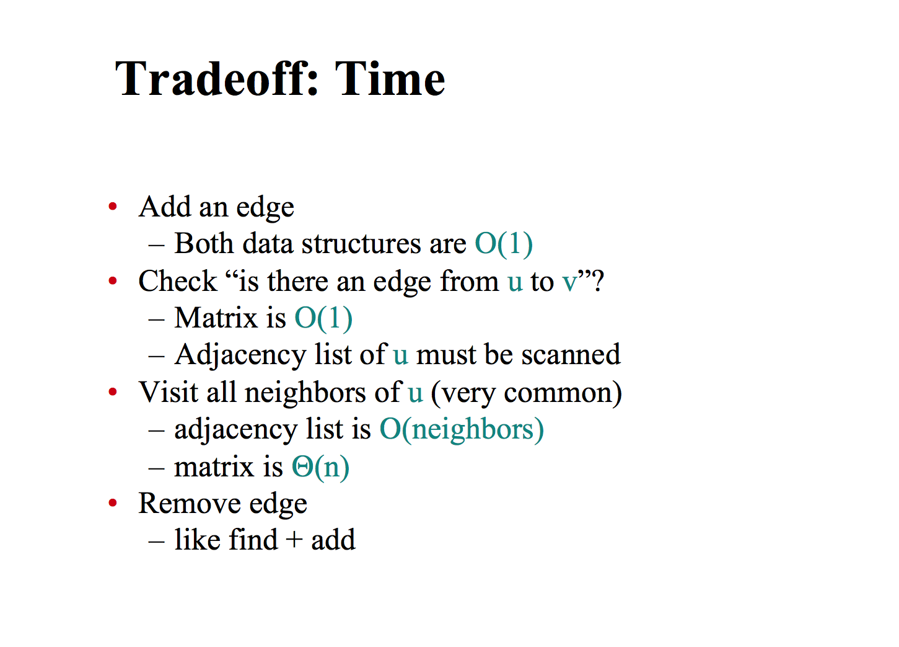

Slide 19
2. TREE

Slide 20
Tree
Tree
a restricted form of a graph
have a parent-child relationship
Directed Acyclic Graph
a single parent
Trees don’t need directed edges: their parent-child relation is implicit from tree structure
Many different trees can be constructed from a given graph
Forest
set of trees

Slide 21
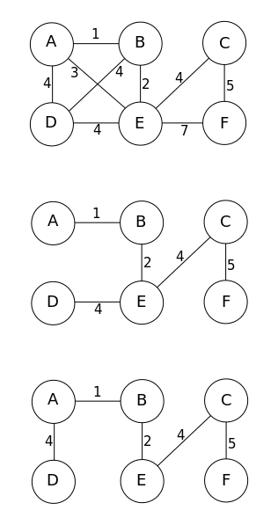
Examples of tree constructions
Graph G
Minimum spanning tree 1,
constructed from G
Minimum spanning tree 2,
constructed from G

Slide 22
3. Search a graph to generate a tree

Slide 23
Graph search
Breadth first search (BFS)
Depth first search (DFS)

Slide 24
Breadth First Search
start with vertex v
list all its neighbors (distance 1 from v)
then all their neighbors (distance 2 from v)
etc.
algorithm starting at v:
define frontier F
initially F={v}
repeat: F’= all new neighbors of vertices in F, F=F’
until all vertices are found
distance = 2
v

Slide 25
Depth First Search
Like exploring a maze
From current vertex, move to another
Until you get stuck
Then backtrack till you find a new place to explore

Slide 26
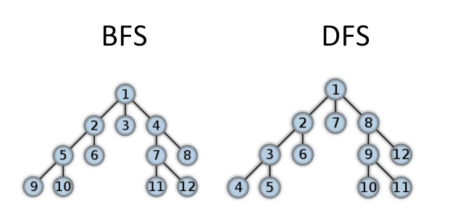
Example: traversal order of BFS vs DFS
(P.S. this is just a node traversal order, not constructing tree from graph)

Slide 27
Problem: Cycles
What happens if unknowingly revisit a vertex?
BFS: get wrong notion of distance
DFS: go in circles
Solution: mark vertices
if you’ve seen it before, ignore

Slide 28

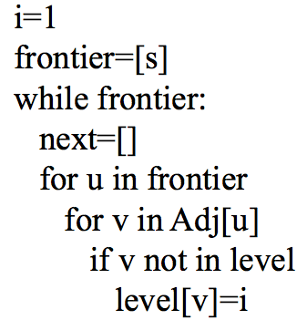
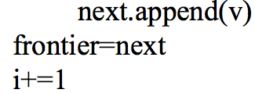
The BFS search algorithm (Array + adj list implementation)
level: stores the nodes seen so far and their distance from the root
frontier: the last level of reachable nodes
parent={s:None}
parent[v]=u
Notes:
The difference with the QUEUE alg is that here we compute the new frontier first

Slide 29
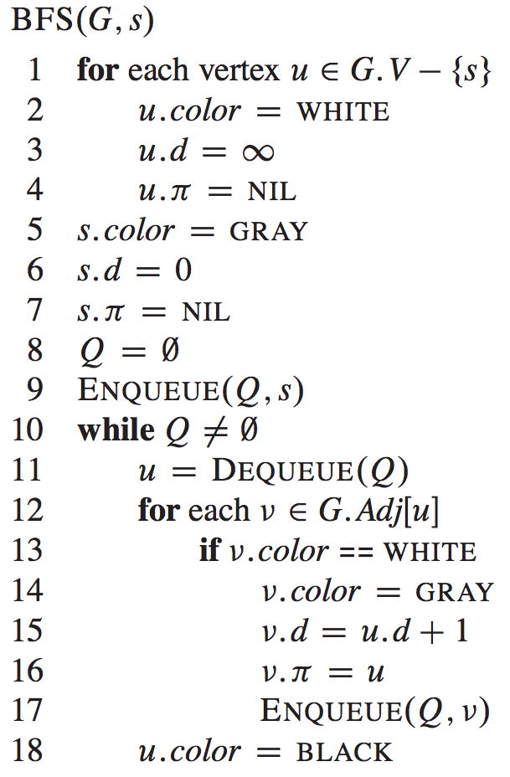
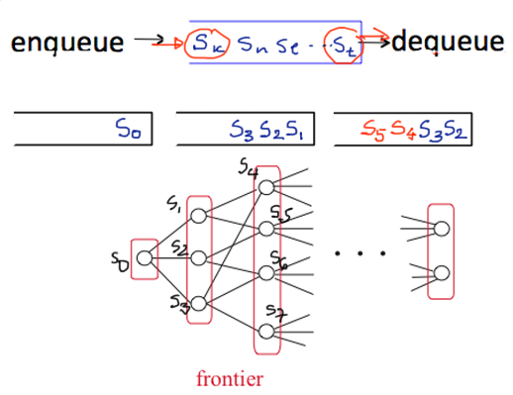
The BFS search algorithm (Queue + adj list implementation)
Replace queue by stack:
it become DFS
Notes:
The difference with the QUEUE alg is that here we compute the new frontier first

Slide 30
Example of BFS
a
s
d
f
z
x
c
v
Class exercise:
1) Build a BFS
2) Mark the level of each node (0,1,2,3)

Slide 31
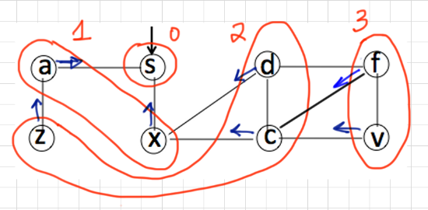
Example of BFS
a
s
d
f
z
x
c
v
Frontier₀ = {s}, frontier₁={a,x}, frontier₂={z,d,c}, frontier₃={f,v}

Slide 32
BFS: level 0
a
s
d
f
z
x
c
v

Slide 33
BFS: level 1
a
s
d
f
z
x
c
v

Slide 34
BFS: level 1
a
s
d
f
z
x
c
v

Slide 35
BFS: level 2
a
s
d
f
z
x
c
v

Slide 36
BFS: level 2
a
s
d
f
z
x
c
v

Slide 37
BFS: level 2
a
s
d
f
z
x
c
v

Slide 38
BFS: level 2
a
s
d
f
z
x
c
v

Slide 39
BFS: level 3
a
s
d
f
z
x
c
v

Slide 40
BFS: level 3
a
s
d
f
X
z
x
c
v

Slide 41
BFS: level 3
a
s
d
f
z
x
c
v

Slide 42
BFS: level 3
a
s
d
f
z
x
c
v

Slide 43
BFS: level 3
a
s
d
f
z
x
c
v

Slide 44
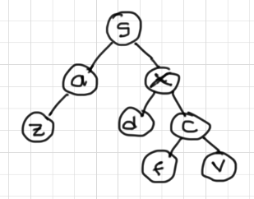
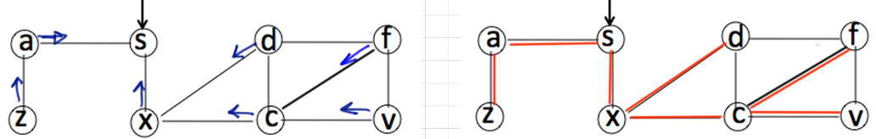
Shortest paths from s
The length of shortest path from s to v
1. is level[v]
2. is ∞ (if it is non-reachable from s)
To find shortest path from s to v, follow
v->parent[v]->parent[parent[v]]->… until s
Notes:
BFS tree: tree generated by parent relation
all nodes reachable from s

Slide 45
Conclusion
Graphs: fundamental data structure
Directed and undirected
4 possible graph representations
Basic methods of graph search (BFS)
Next lecture:
DFS
Loops, topological sorting

